Slide 1
Cost estimation
To estimate software cost:
  Determine size of the product.
  Using size estimation,
    determine effort needed.
  From the effort estimation,
    determine project duration, and cost.

Slide 2
Cost estimation
Cost estimation techniques:
  Empirical Techniques
  Heuristic Techniques
  Analytical Techniques
Empirical techniques are based on systematic guesses made by experts:
  Expert Judgement
  Delphi Estimation

Slide 3
Cost estimation
Heuristic techniques:
  assume that different product parameters are related through a simple mathematical expression:
  COCOMO
Analytical techniques:
  derive the estimates starting with some basic assumptions
  Halstead's Software Science

Slide 4
Staffing
Project Managers usually take responsibility for choosing their team:
  need to identify and select good software engineers for the success of the project.

Slide 5
In Staffing level:
Number of engineers at any phase depends on the number of parallel activities possible.
Maximum number of engineers required during testing.

Slide 6
Who is a Good Software Engineer?
Good programming abilities
Good knowledge of the project areas (Domain)
Exposure to Systematic Techniques
Fundamental Knowledge of Computer Science
Ability to work in a team
Intelligence
discipline
Good communication skills:
  Oral
  Written
  Interpersonal
High Motivation

Slide 7
Scheduling
Scheduling is an important activity for the project managers.
To determine project schedule:
  Identify tasks needed to complete the project.
  Determine the dependency among different tasks.
  Determine the most likely estimates for the duration of the identified tasks.
  Plan the starting and ending dates for various tasks.

Slide 8
Work Breakdown Structure
Work Breakdown Structure (WBS) provides a notation for representing task structure:
  Activities are represented as nodes of a tree.
  The root of the tree is labelled by the problem name.
  Each task is broken down into smaller tasks and represented as children nodes.
It is not useful to subdivide tasks into units which take less than a week or two to execute.
  Finer subdivisions mean that a large amount of time must be spent on estimating and chart revision.

Slide 9
Work Breakdown Structure
Compiler Project
Requirements
Design
Code
Test
Write Manual
Lexer
Parser
Code Generator

Slide 10
Activity Networks
WBS structure can be refined into an activity network representation:
  Network of boxes and arrows
  shows different tasks making up a project,
  represents the ordering among the tasks.
It is important to realize that developing WBS and activity network
  requires a thorough understanding of the tasks involved.

Slide 11
Activity Network
Code Lexer
Design
Code Parser
Requirements
Test
Code Code Generator
Write Manual

Slide 12
Gantt Charts
Named after its developer Henry Gantt.
  a form of bar chart:
    each bar represents an activity,
    bars are drawn against a time line,
    length of each bar is proportional to the length of time planned for the activity.

Slide 13
Gantt Charts
Gantt charts are not specific to software engineering.
Gantt charts used in software project management are:
  enhanced version of standard Gantt charts.
  colored part of a bar shows the length of time a task is estimated to take.
  white part shows the slack time,
    the latest time by which a task must be finished.

Slide 14
Gantt Chart
Requirements
Design
Code Lexer
Code Parser
Code Code Generator
Test
Write Manual

Slide 15
Critical Path
Task dependencies define a partial ordering among tasks, i.e.
  Completion of some tasks must precede the starting time of some other tasks.
A critical path:
  along which every milestone is critical to meeting the project deadline.
A Critical Path is a chain of tasks that determine the duration of the project.

Slide 16
Critical Paths
A critical paths is sequence of tasks such that
  a delay in any of the tasks will cause a delay to the entire project.
There can be more than one critical path in a project.
It is important for the project manager to be aware of the critical paths in a project:
  can ensure that tasks on these paths are completed on time.

Slide 17
Example
A project involves three tasks:
  task a takes 4 hours,
  task b takes 5 hours
  task c takes 8 hours.
  task c cannot commence until task a is completed.
What is the shortest time in which the project can be completed?
b
5
finish
start
4
a
c
8

Slide 18
Example
Clearly, the project continues until task a and then task c complete:
  which is 12 hours.
  Task b takes only 5 hours.
  Task b can have 7 hours of leeway to start and finish.
b
5
finish
start
4
a
c
8

Slide 19
What data do we need to construct a CPM graph?
To construct a CPM graph,
  a list of tasks and their durations are required.
  Also, for each task a list of tasks upon which it depends is required.
  A task may depend on more than one task.
Project task details can be given in the form of a table.

Slide 20
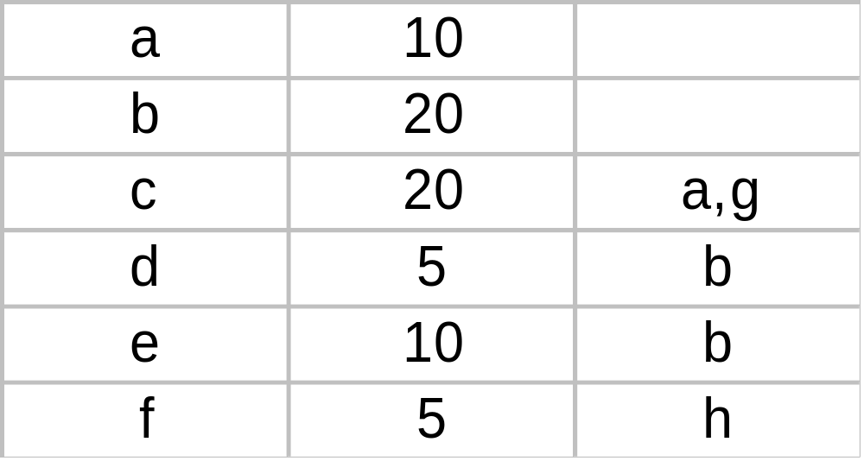
Task Table
Task Duration Dependents

Slide 21
CPM Graph
c:20
a:10
start
finish
g:5
b:20
f:5
d:10
e:10

Slide 22
Project monitoring and control
Milestone are set by project manager to measure the progress of success of software.
PERT chart helps in it, it delay is encountered , manager need to account the plan again with new deadlines and targets.

Slide 23
Organisation and Team Structure
two types:
  Functional format : the development staff is divided based on the functional group to which they belong
  Project Format : development staff are divided based on the project for which they work.

Slide 24
Team organization:
  Chief programmer: Suitable for routine development work.
  Democratic: Suitable for small teams doing R&D type work.
  Mixed: Suitable for large organizations.

Slide 25
Risk Management
A risk is any unfavourable event or circumstance:
  which might hamper successful or timely completion of a project.
Risk management:
  concerned with the reduction of the impact of risks.
Risk management consists of three activities:
  risk identification,
  risk assessment, and
  risk containment.

Slide 26
Risk identification
To be able to identify various risks:
  we must list them down and categorize risks into different classes in order to systematically identify the important risk.

Slide 27
Three main categories of risks can affect a software project:
  project risks
  technical risks
  business risks

Slide 28
Project Risks
Project risks associated with: since software is intangible that’s why suffer from schedule slippage many times
  budget,
  schedule,
  personnel,
  resource, and
  customer problems.

Slide 29
Technical Risks
Technical risks concern: occurs due to development team insufficient knowledge
  requirements specification
    (e.g ambiguous, incomplete, changing specifications)
  Design and implementation problems,
  interfacing problems,
  testing, and maintenance problems.
  technical uncertainty, and technical obsolescence are technical risk factors too.

Slide 30
Business Risks
Business Risks include:
  building an excellent product that no one wants,
  losing budgetary or personnel commitments, etc.
It is a good idea to have a “company disaster list”,
  a list of all bad things that have happened in the past
  project managers can jog their mind to see which items their project is vulnerable to.

Slide 31
Risk assessment
Objective of risk assessment is to prioritize the risks:
  Likelihood of a risk being real (r ).
  Consequence of the problems associated with that risk (s ).
Prioritization helps in handling the most damaging risks first (p )
P=r*s
Because of this more likely risks can be handled first

Slide 32
Risk Handling/ Containment
Three main strategies for risk handling:
  Avoid the risk: discuss with customer to change the requirements to reduce scope of work.
  give incentives to development team to avoid man power turnover

Slide 33
  Transfer the risk:
  allocate risks to third party
  or buy insurance to cover any financial loss should the risk become a reality.
  Contingency planning/Risk Reduction: Prepare contingency plans to minimize the impact of the risk. Ex. New recruitment if someone gonna leave.

Slide 34
To decide about risk handling options, we must take into account:
  cost of reducing risk
  resulting cost saving from risk reduction.

Slide 35
Risk Containment
To consider the cost we may compute risk leverage of different risks.
Risk leverage= (risk exposure before reduction - risk exposure after reduction) / cost of reduction

Slide 36
  schedule slippage
    can be dealt with by increasing the visibility of the project.
Milestones are placed at regular intervals
  provide a manager with regular indication of progress.

Slide 37
Software Configuration Management
The results (aka deliverables) of any large software development effort consists of a large number of objects:
  source code,
  design document,
  SRS document,
  test document,
  project plan (SPMP) document, etc.

Slide 38
These softwares are modified by number of developers throuhgout the life cycle.
The state of all these objects at any point of time is called configuration and it changes each time development progresses.

Slide 39
Software Configuration Management (CONT.)
A configuration is a collection of deliverables:
  being developed for some customer.
As development proceeds,
  the components comprising a configuration undergo changes:
  Even during maintenance, the components comprising a configuration keep changing.

Slide 40
Versions/New Release
A configuration for a particular system is called a version:
  The initial delivery might consist of several changes in functionality, technology and hardware .
  A new release ic created if only bug fix and minor enhancement in functionalities and usability.

Slide 41
Versions
As a software is released and used by the customers:
  errors are discovered,
  enhancements to the functionalities might be needed.
A new release of the software is an improved system intended to replace an old one.
Usually a product is described as version m and release n (or as version m.n)

Slide 42
Nacessity of software configuration management
It is done to control the access of different software objects. The following problems are faced if configuration management is not used:

Slide 43
Inconsistency problem when the objects are replicated. (Changes made to each local copy independently)
Problem associated with concurrent access(changes made in same copy by different people)
System accounting and maintaining status information(keep track of time and who made the change)

Slide 44
Handling variants: Copies of same module , if found bug in one, needs to be fixed in all but SCM manages all copies using tools.
Providing a stable development environment: A odule follows B, Changes made in B 10 times, 10 times a should be compiled. So project manager sets a baseline.

Slide 45
BASELINE: when anyone need to change any object under configuration, he gets a private copy of baseline. When he is done with all modifications , new baseline is set.

Slide 46
Software Configuration Management Activities
Done by project manager through automated configuration management tools. It keeps track of objects to detect state of project quikly.

Slide 47
It is achieved through two activities:
Configuration identification
  which parts of the system must be kept track of?
  It this objects are classified in three categories:
  Controlled: which are already under configuration control you need to follow formal procedure to change them.

Slide 48
  Precontrolled: not yet but about to be under config. Control.
  Uncontrolled: not and will not be under config control.
  Configuration management plan only keep track of controlled objects and list of controlled object already mentioned in this plan

Slide 49
Configuration control
  ensures that changes to an object is done only by authorised developer and not by unauthorised people.
  Configuration management tool allow only one person to reserve the module unless restored, noone will get access. Resolve problem of concurrent access

Slide 50
Process of configuration control
Developer get copy of object through reserve operation make changes.
Restoring the changed module require permission from Change Control Board (CCB). On the basis of:
Change is well motivated
Properly documented
Validated by majority of CCB
Compatible with other changes in s/w
Then update baseline

